Slide 1
Biophysics
BT 301 Aug 2022

Slide 2
Fluorescence Spectroscopy

Slide 3
JABLONSKI DIAGRAM

Slide 4
JABLONSKI DIAGRAM

Slide 5
Excitation and Emission of Fluorescence

Slide 6
Absorption and Emission Spectra

Slide 7
Fluorophores

Slide 8
FLUORESCENCE demonstration

Slide 9
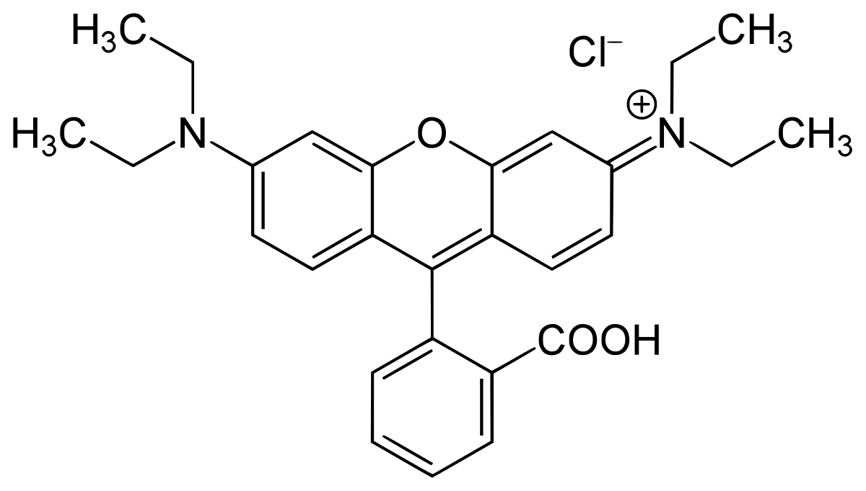
Rhodamine B

Slide 10
Rhodamine B Excitation/Emission spectra

Slide 11
Solvent relaxation, Fluorescence Quenching and Forster Resonance Energy Transfer

Slide 13
Measuring Steady State Fluorescence

Slide 14
Measuring Steady State Fluorescence

Slide 15
Time-resolved Fluorescence

Slide 16
Intrinsic Fluorophores characteristics

Slide 17
Extrinsic Fluorophores characteristics

Slide 18
Extrinsic Fluorophores structures

Slide 19
Extrinsic fluorescent probes for covalent labelling

Slide 20
Increase in ANS fluorescence on addition of human serum albumin
Increase in TNS fluorescence on addition of:
DMPC membrane vesicles
Apomyogobin protein

Slide 21
Schematic diagram of steady state
spectroflurometer

Slide 22
Schematic of photomultiplier tube and dynode chain

Slide 23
Spectral response curves of typical photocathodes

